Slide 1




Slide 2
Synopsis Presentation
Medicine Recommendation System
Presented By:
Jayant Dev, SAP - 500120083
Devansh Maheshwari, SAP - 500117998
Sunil Singh, SAP – 500123144
Vinay Kumar Pandey, SAP - 500120087
Mentor:
Prof. Dhivya J Rose.
School of Computer Science | UPES

Slide 3
Abstract
Medicine Recommendation System (MRS): AI-driven system to recommend medicines based on patient data.
Goal: Improve prescription accuracy and reduce human errors.
Approach: Compare Support Vector Machines (SVM) and Random Forest (RF) for personalized medicine recommendations.
Key Focus: Performance, efficiency, and scalability of models in clinical settings.

Slide 4
Introduction
Overview of MRS: Personalized treatment suggestions based on patient profiles, symptoms, and medical history.
Need: Efficient and accurate medication suggestions to enhance healthcare.
AI in Healthcare: Emerging as a tool to improve diagnosis and treatment decisions.

Slide 5
Literature Review
SVM: Traditional machine learning method, good for binary classification but requires manual feature extraction.
Random Forest: Combines decision trees; robust for categorical and numerical data but less interpretable as it scales.
Current Studies: AI-driven systems show significant improvement in diagnosis and treatment recommendations.

Slide 6
Problem Statement
Challenge: Accurately recommend medicines by analyzing diverse patient data (age, symptoms, medical history, and drug interactions).
Goal: Identify the most effective model (SVM, RF) for real-time medicine recommendations.
Focus: Balance accuracy, computational efficiency, and scalability in real-world clinical applications.

Slide 7
Research Goal (Objective)
Goal 1: Compare the performance of SVM, and Random Forest in medicine recommendation tasks.
Goal 2: Address limitations like computational complexity and overfitting in existing models.
Goal 3: Develop an optimized, scalable system for use in clinical environments.

Slide 8
Methodology
Data Collection: Use datasets Medicine Recommendation System Dataset. Kaggle. Retrieved from https://www.kaggle.com/datasets/noorsaeed/medicine-recommendation-system-dataset with patient demographics, medical history, and drug information.
Preprocessing:
Data normalization and augmentation.
Feature extraction for SVM, automated learning and random sampling for Random Forest.
Model Development: Train SVM and RF models, perform hyperparameter tuning, and cross-validation.
Evaluation Metrics: Accuracy, precision, recall, F1-score, and computational efficiency.

Slide 9
Change in Approach
Previous Approach: We initially used SVM and Random Forest for the medicine recommendation system.
New Approach: We’ve now incorporated SVC, Gradient Boosting, and Random Forest for improved performance:
SVC for non-linear decision boundaries.
Gradient Boosting for higher predictive accuracy.
Random Forest for robustness and reducing overfitting.
Expected Benefits:
Enhanced model performance and accuracy.
More diverse models for better handling of different data scenarios.

Slide 10
Algorithms
Algorithm | Pros | Cons
SVC | Effective in high-dimensional spaces; robust with kernels | Struggles with large datasets; sensitive to noise and outliers
Random Forest | Reduces overfitting; handles both regression and classification tasks | Can be computationally expensive; less interpretable
Gradient Boosting | High predictive power; effective on imbalanced data | Prone to overfitting without careful tuning; computationally expensive

Slide 11
Technical roadmap of the system
Phase | Duration
Data Pre-processing | 2 weeks
Model Development | 3 weeks
Model Training & Testing | 3 weeks
Evaluation & Optimization | 2 weeks
Final Report & Presentation | 2 weeks

Slide 12
SVC – Support Vector Classifier
Purpose: SVC can be used to classify patients into different groups based on their medical conditions, symptoms, and demographics to recommend the most appropriate medicine.
How It Works:
Data: The system uses patient data (e.g., age, symptoms, medical history) as input features.
Classification: SVC identifies patterns in the data and classifies patients into categories, such as high-risk or low-risk for certain conditions.
Medicine Recommendation: Based on the classification, the system suggests personalized medicine options for each patient category.
Advantages of Using SVC:
High accuracy: SVC is effective in high-dimensional data, which is common in medical datasets.
Kernel trick: Can handle non-linear relationships in data, which might be the case for medical symptoms and conditions.
Robustness: SVC is less prone to overfitting compared to other models, making it suitable for medical applications where generalization is key.

Slide 13
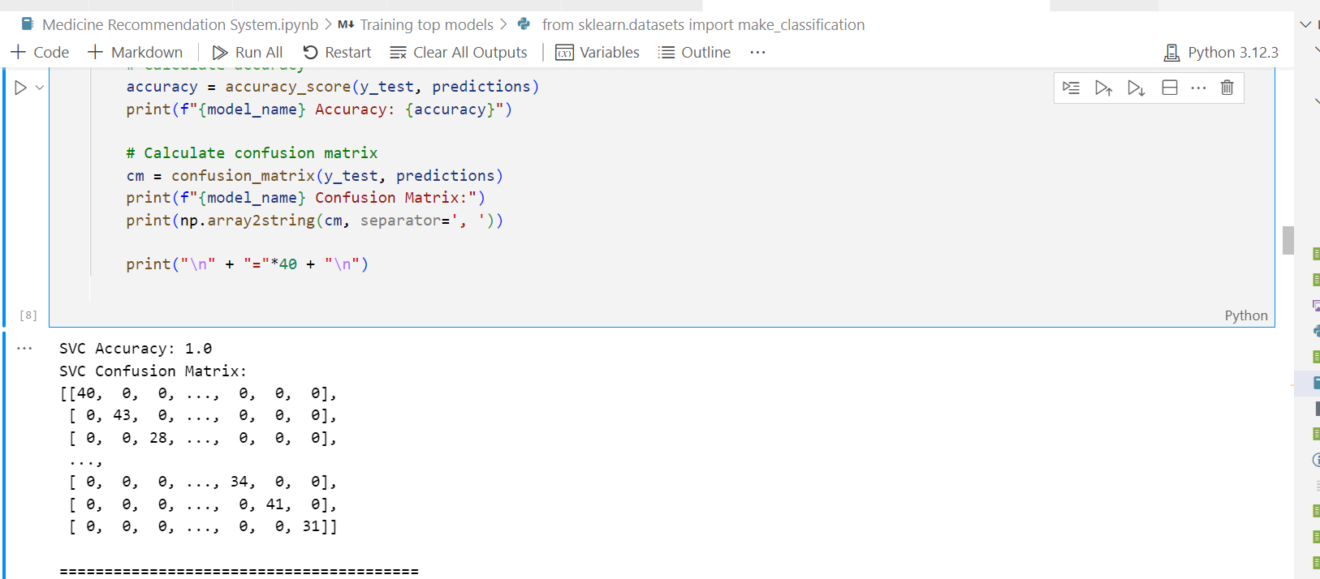
support Vector Classifier (SVC) is 1.0, it means that your model has perfectly predicted all the samples in the test set without any errors. However, this doesn't necessarily mean the model is optimal or that it is performing well in all aspects. Here are a few things to consider when dealing with a model that shows 100% accuracy

Slide 14
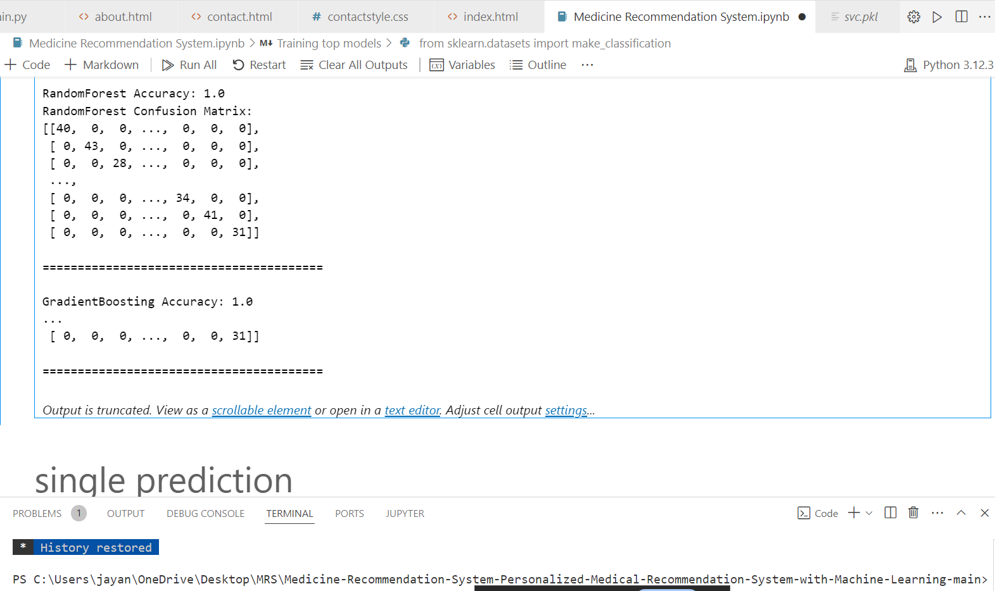
Random Forest and Gradient Boosting models achieve 1.0 accuracy, it indicates that the models have perfectly predicted all the samples in the test set.

Slide 15
Conclusion
Best Performing Model: To be determined based on evaluation metrics.
Key Takeaway: AI-based systems have significant potential for improving medicine recommendations in clinical settings.
Future Work: Explore hybrid models and real-time data integration for even more accurate recommendations.

Slide 16
References
Breiman, L. (2001). Random Forests. Machine Learning.
Guyon, I., et al. (2002). Gene selection for cancer classification using support vector machines. Machine Learning.
Hastie, T., Tibshirani, R., & Friedman, J. (2009). The Elements of Statistical Learning. Springer.
Lundberg, S. M., & Lee, S. I. (2017). A unified approach to interpreting model predictions. Advances in Neural Information Processing Systems.

Slide 17
THANK YOU

